Slide 1
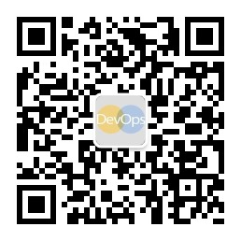
业务敏捷化的云转型之路
徐磊
Microsoft Regional Director
Microsoft Most Valuable Professional

Slide 2
2
/
60%
29%
3
大约
企业员工
消费者每周至少有3-4天是使用移动设备 来获取信息
的企业员工采用 移动办公 的方式工作，同时使用 3台 以上的设备，通过不同的APP，在 不同的地点 完成工作
认为 I.T. 并没有为他们提供足够高效的协作，数据分析 和 移动办公 能力
51%
14
80%
CIO
亿
接近
的企业员工在 办公室以外 完成一部分的额工作
认为当前的 数字化浪潮 对他们提出了非常大的 挑战
GLOBAL CONSUMERS
WITH TABLETS AND SMARTPHONES BY 2016
Notes:
Key points:
As we all know, mobile has become a top megatrend—alongside three other key trends: enterprise social, big data, and cloud computing. The numbers being reported by analysts and the press speak for themselves. People are engaging en masse in mobile computing. They love their mobile devices, and they are highly productive on them. In fact, people love their devices so much that in one survey of mobile phone users in the United States, over half said they would give up caffeine, chocolate, alcohol, and other pleasures before giving up their mobile phone.
For businesses, mobile is rapidly becoming the new normal and is driving a change in how we work:
According to some estimates, by 2016, 350 million employees will use smartphones for business, and 200 million will bring their own. In fact, information workers already use a variety of self-purchased devices to make themselves more productive on the go, even if it is just to access the Internet and check email. One study found that 95 percent of information workers use at least one self-purchased device for work.
New powerful, business-ready devices will enable workers to be or stay in the field—close to their work, their teams, and their customers. They will be able to keep key workflows moving and shorten the time it takes to resolve customer issues. Today, nearly eight in ten workers spend at least some of their time working out of the office. Three of those ten workers are currently considered to be fully mobile “anytime, anywhere information workers” who use three or more devices, work from multiple locations, and use lots of apps.
For consumers, mobile is equally important:
Gartner has predicted that 1.2 billion smartphones and tablets will be shipped in 2013 and that mobile devices accounted for 70 percent of all devices sold in 2012.
By the year 2016, mobile devices will put power into the pockets of 1.4 billion consumers. People have never been more accessible and connected.
Nearly two-thirds of consumers today use their mobile phones to get information about products, brands, or destinations at least three to four times per week, often looking for information at the point of purchase or decision making.
Ninety percent of consumers use multiple screens daily, for instance starting on smartphones, moving to the PC, and perhaps finishing tasks on tablets.
The challenge for business and IT leaders is to develop and implement an enterprise-wide mobile strategy together that embraces the opportunity to forge deeper, richer connections with both employees and customers while maintaining enterprise-grade security and availability.
Sources:
“Today we characterize 29% of the global workforce as anytime, anywhere information workers -- those who use three or more devices, work from multiple locations, and use many apps.” Forrester Research, “2013 Mobile Workforce Adoption Trends,” February 2013. http://www.forrester.com/2013+Mobile+Workforce+Adoption+Trends/fulltext/-/E-RES89442
“Nearly 80% of workers [spend] at least some portion of their time working out of the office.” Strategy Analytics, “Enterprise Mobility Market 2012 & Beyond,” May 2012. http://mslibrary/research/MktResearch/Others/Pages/StratAnalytics/SAWeb/reports/r07388/report07388.pdf
“Nearly two-thirds of consumers now use their mobile/smartphones to obtain information about products, brands or destinations at least three to four days a week.” Fleishman Hillard, “Understanding the role of the Internet in the lives of consumers: 2012 Digital Influence Index Annual Global Study,” January 2012. http://fh.pr/digitalinfluenceindex
“65% of U.S. shoppers research products and services on a PC and make a purchase in-store.” Cisco, “Catch and Keep Digital Shoppers,” January 2013. http://www.cisco.com/web/about/ac79/docs/retail/Catch-and-Keep-the-Digital-Shopper_PoV.pdf
“‘The global installed base of smartphones will total 1.4 billion by the end of 2013.” ABI Research, Mobile Application Technologies Research Service, January 2013. http://www.abiresearch.com/press/45-million-windows-phone-and-20-million-blackberry
“90 percent of consumers use multiple screens daily.” Google, “The New Multiscreen World, Understanding Cross-Platform Consumer Behavior,” August 2012. http://www.google.com/think/research-studies/the-new-multi-screen-world-study.html
“Fifty-one percent of CIOs are concerned that the digital torrent is coming faster than they can cope, and 42% don't feel they have the talent needed to face this future.” Aron, Dave, and Graham P. Walker. Taming the digital dragon: the 2014 CIO agenda. Gartner, Inc. December 31, 2013.

Slide 3
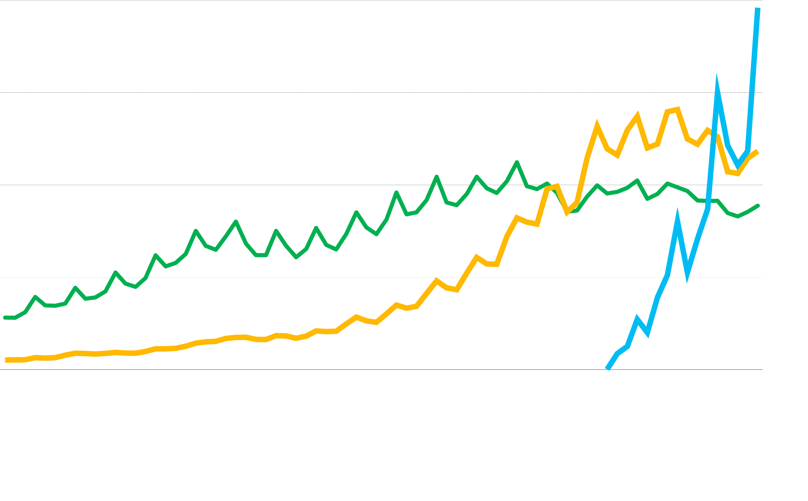
80
60
移动
成为主流
设备出货量（百万）
40
20
1995
1997
1999
2001
2003
2005
2007
2009
2011
2013
Desktop PCs Notebook PCs Tablets
Source: KPCB/Mary Meeker. Internet Trends 2014: Code Conference
Notes:
Key points: The total device market is growing – you can see a dramatic increase in tablet growth, and that’s additive. （加速增长）

Slide 4
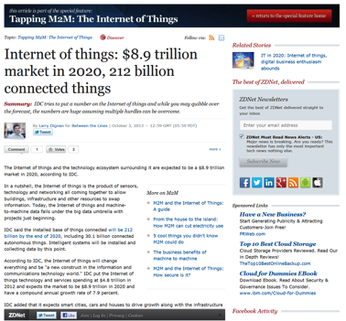
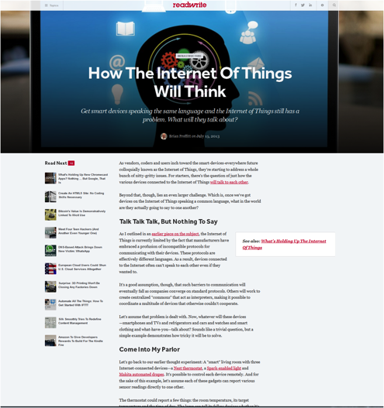
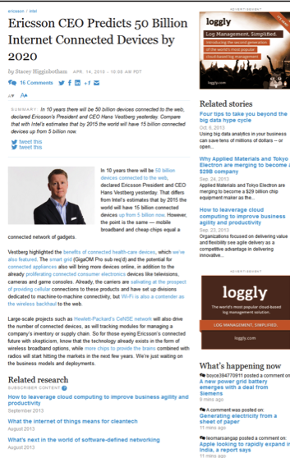
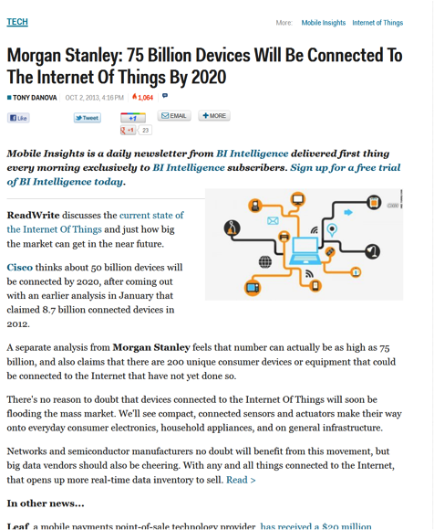
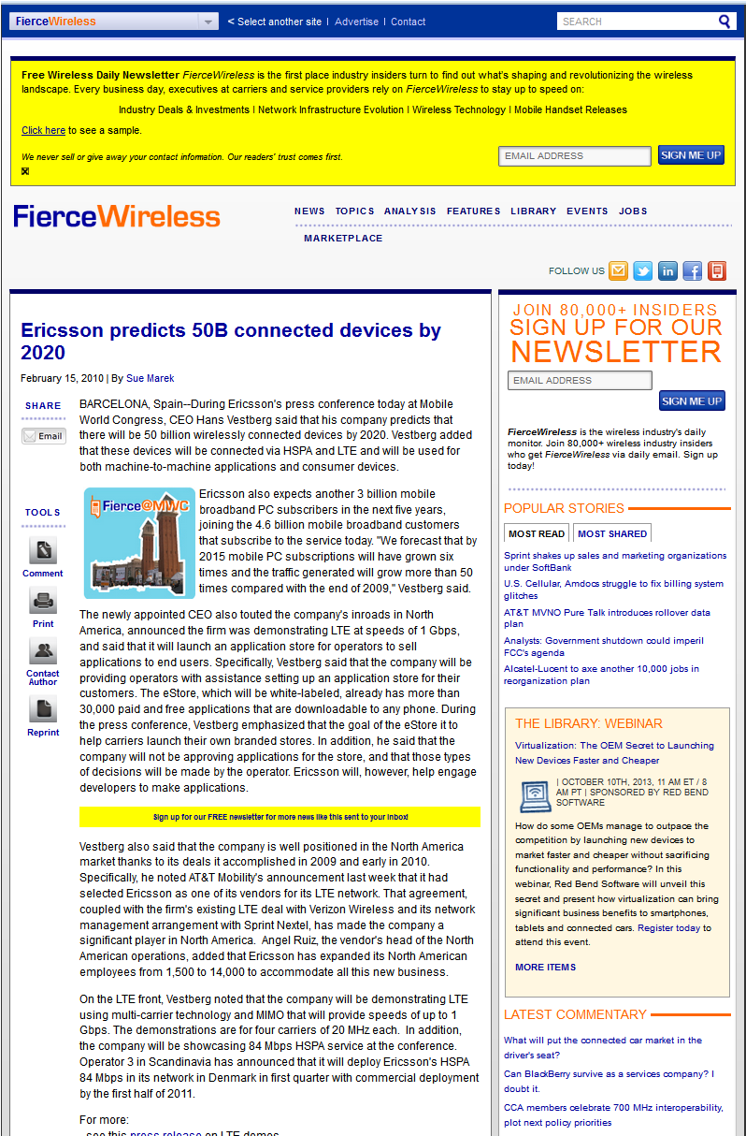
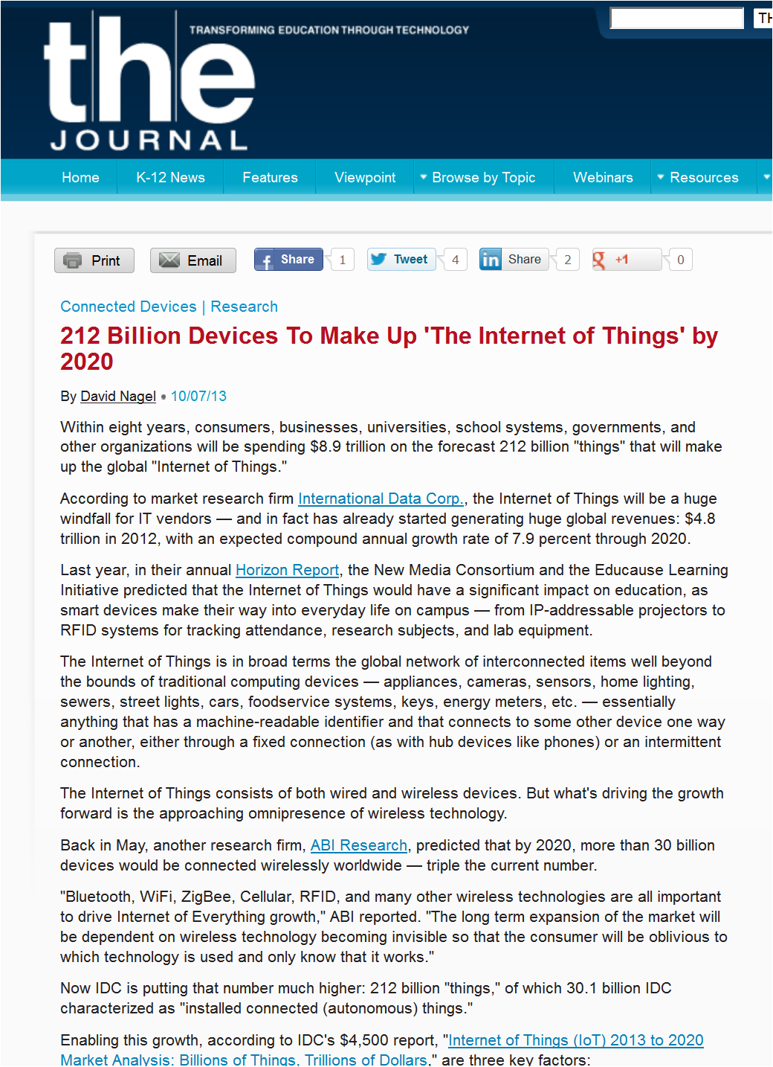
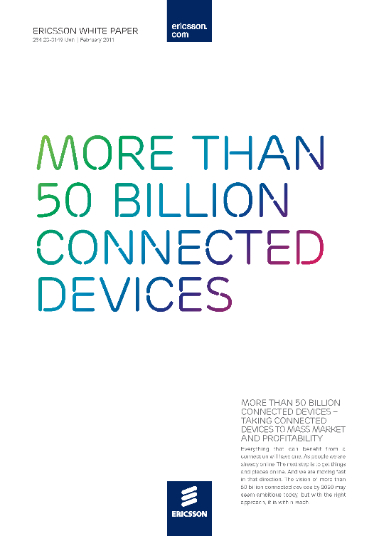
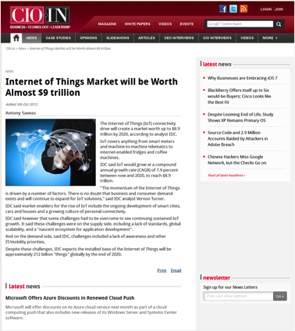
物联网: 预测
7
2
5
5
1
0
B
2
Notes:
How huge? Ericsson estimated 50B connected devices. Then Morgan Stanley estimated 75B. Then IDC came out with 212B. So we don’t know. But it’ll be huge. And these are non-traditional devices. This is where we really get into that ambient intelligence that Satya touched on – computing everywhere, developing and delivering and making massive amounts of data accessible in ways it hasn’t been before.
爱立信：500亿
摩根斯坦利：750亿
IDC： 2120亿

Slide 5
当前的SaaS应用部署模式? 混合模式: 包含私有数据中心，托管服务商和公有云
80% SaaS使用私有数据中心 |  | 主要原因
< 2% | 公有云 | 快速实现，快速部署 全球覆盖
18% | 托管服务 | 运维和基础架构服务外包
39% | 私有 + 托管服务 | 特定地理区域覆盖，同时保证内部用户的访问等 优化硬件资源使用率
41% | 私有数据中心 | 应用架构复杂，并包含大量定制化 对运维的完全控制，以保证内部用户的访问等级 企业规模成本模式，依靠资本性投资满足增长
Source: IDC Direction 2014, Transformation Everywhere How SaaS Gets Built, March 2014

Slide 6
为什么要选择微软云平台 完整的混合云解决方案
一个 统一的云平台满足ISV的所有需求
< 2% | 公有云
18% | 托管服务
39% | 私有 + 托管服务
41% | 私有数据中心
Microsoft Cloud OS
Customer
ONE
Consistent Platform
Service Provider
Microsoft
ISV可以从私有数据中心无缝过渡到公有云平台
Source: IDC Direction 2014, Transformation Everywhere How SaaS Gets Built, March 2014

Slide 7

微软云平台
你的SaaS应用平台
多租户
虚拟化集成
Microsoft
数据平台
One
Consistent Platform
统一管理
On-Premises
Service Provider
统一认证
灵活部署
微软云平台提供跨私有云，公有云和托管服务商的无缝集成能力
Notes:
Microsoft’s cloud platform, Cloud OS, is uniquely positioned to ISV partners to get all the benefits of scale, speed, and agility while still protecting existing investments, allowing them to move to the cloud with confidence. The key to the Microsoft Cloud OS approach is to provide one consistent platform and a set of common capabilities that allow customers to flexibly extend services across on-premises, private cloud and public cloud. ISV partners can grow your business with Microsoft Cloud OS no matter where you start.
This is powerful because we will deliver a flexible development environment for the developer so that it can code once and deploy anywhere; deploy on premises, deploy out to a partner cloud, deploy out to Azure cloud. But they only have to write the app once on the power of our .NET framework.
Unified management is our ability to use System Center, sitting in your datacenter to administer all the automation scripts to manage and pool the resources of that datacenter. Well while you’re looking in that pane of glass, to be able to provision and move VMs, objects, data from your datacenter out through a service provider or out to Azure for bottomless storage, for redundancy, for disaster recovery.
Common identity is a third element of our consistent platform, using Active Directory group policies that you’ve already set up in your enterprise. You merely get the benefit of those group policies extended through Active Directory Federation Services and Azure based Active Directory, so that the group policies you set, extend out to the cloud automatically. You don’t have to manage multiple federation common identity across different clouds.
Integrated virtualization is a fourth area. You no longer have to have a third part bolt on to virtualize your compute. Not only are we giving you compute capability, virtualization of your compute capability imbedded in Windows Server, we’re giving that to you around software defined networking and around virtualization of storage, also.
Lastly, being able to have a complete data platform where your data can reside anywhere across these three clouds in a seamless way is a value proposition that’s huge as well. You can optimize your storage costs in this dimension. All that capability integrated in how we think about the complete data platform for a customer across all clouds.
Our hybrid design gives you the ability, from a one view, to manage apps and data beyond your own private cloud -- to a partner cloud -- to a public cloud -- in a consistent way.
Removes complexity so you can focus on answering those business questions and apps
Helps you be very flexible in thinking about how you deploy your apps across the three clouds

Slide 8
功能丰富且灵活的混合云平台 无论你的应用现在位于何处
Microsoft Azure 公有云
开发
部署
管理
监控
托管服务商
内部私有云

Slide 9
微软云平台 为应用而生
应用托管 (SaaS/PaaS/IaaS)
桌面托管 through RDS
Foundation for Hosting Service Provider Offers
ISV Control Panels | Custom Control Panels | Service Management Portal
Service Management API (REST OData)
Windows Azure Pack & Service Provider Foundation API
提供标准化管理API
Windows Server 2012 R2
提供强大的可扩展的底层支撑
System Center 2012 R2
提供统一的管理平台
Windows Server 2012 R2
Web |  | Applications |  | Remote Desktop Services
Networking | Storage |  | Management |  | Active Directory
Virtualization with Hyper-V |  | Multi-Tenancy |  | Availability / Scalability / Security
System Center 2012 R2
Service Provider Foundation API
OS & Application Monitoring
Automation & Self-Service
Infrastructure Provisioning
Compute | Storage (File/Block) | Network

Slide 10
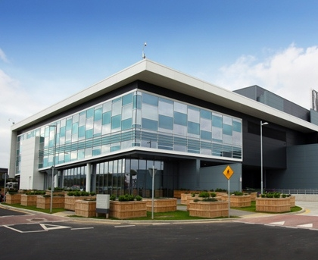

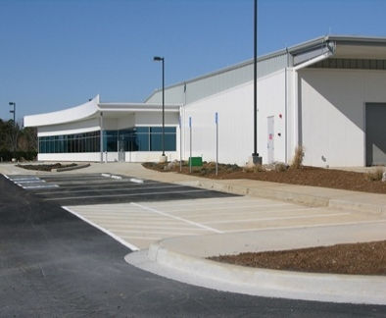
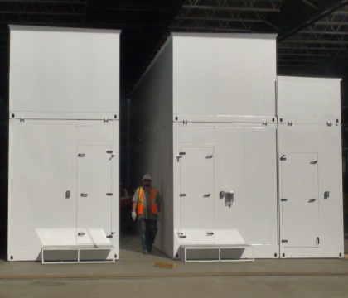


kr
kr
$
€
руб
£
chf
$
₩
¥
TL
$
全球数据中心节点
全球CDN节点
全球支持
Rp
本地化团队
$
R
本地化结算
$
$
24 x 7 x 365 support Over 1 billion customers, 20 million businesses 76 markets worldwide
280 years of combined industry experience in infrastructure, security, product dev, and global ops

Slide 11

从数字看微软云
June 2013
250,000
50% 的全球财富500强企业在使用

Slide 12









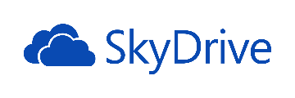

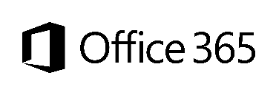

微软自营业务
Bing holds 18.2 percent of US market share
Skype users spend up to 2 billion minutes per day using the service
Over 250 million people use OneDrive
1.5 Billion games of Halo
Yammer now has over 8 million registered users
48 Million Subscribers in 41 countries
Dynamics CRM serves over 3.5 million users
11 billion stored photos
Outlook.com has over 400 million active users and is the world’s fastest growing email service
1 Billion mobile notifications a month
Nearly 50 million Office Online users
Xbox delivered over 740 million hours of entertainment
Notes:
Key Points: Microsoft’s service platform supports not only partners as a platform provider, but supports Microsoft’s own business. The platform is battle-tested at scale.
In many ways, Microsoft’s cloud starts with first-party services. Between services they’ve built and services they’ve acquired - Microsoft has invested to become the second-largest provider of end-user services on the planet. (Google is first, Microsoft is second.) They service hundreds of millions of people and billions of transactions. What that means is that they’ve learned a LOT about managing services at scale. Over time with a lot of investment, they’ve built datacenters around the world. They’ve scaled up for data privacy and scalability and redundancy – all as mission-critical requirements – to provide these services with reliable uptime around the world, and they’ve learned how to do it.

Slide 13


APIs
Designed for openness and flexibility
SDKs
Contextual awareness
Key app adoption
Entities
Storage
Analysis
High value end to end scenarios
Android SDK
iOS SDK
Enabling a consistent development platform
XBOX, Lync,
O365 integration
for business
Mail
Azure
Calendar
Machine Learning
Apps level operations
Office and SharePoint integration
People
Powering a world of devices
Data
Search
Drive SQL 2014
HDInsight, Power BI
Apps publishing program
Showcase Wins
Social
Notes:
Key Points: Microsoft’s service platform is extensible.
Microsoft is a partner-driven company. So we make these services a platform. That means, for example, that Office 365 can be the front end for your LOB applications. Bing can provide text-to-speech translation, mapping, language translation, Bing entities – those are Microsoft services that partners can leverage. That ecosystem continues to grow – services from Microsoft and services from Microsoft partners as well.

Slide 14
谢谢！

